Slide 1

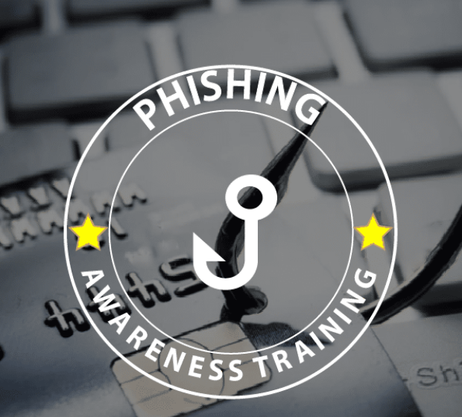
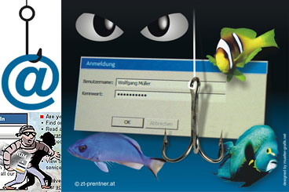

PH
By
Puskur Harika

Slide 2

Introduction to Phishing
What is Phishing?
Phishing is a form of cyber attack where attackers impersonate legitimate organizations or individuals to trick you into disclosing sensitive information like passwords, credit card numbers, or personal details.
Phishing can occur via email, social media, phone calls, text messages, and websites.
Impact of Phishing Attacks:
Financial loss, identity theft, unauthorized access to accounts, data breaches, etc.
According to recent studies, phishing is one of the most common methods of cybercrime.

Slide 3
Different Kinds of Phishing Attacks
Content:
Email Phishing:
The most common type. You get an email from someone pretending to be your bank or a company you know.
Spear Phishing:
More personal. These attacks are aimed at specific individuals (like you!) using info they know about you.
Smishing:
Text message phishing. A message asking you to click a link or call a number.
Vishing:
Voice phishing. You get a phone call from someone claiming to be from your bank or tech support.
Whaling:
Phishing aimed at high-profile targets, like company executives.

Slide 4
How Phishing Works (And How to Spot It)
Title: How Do These Phishers Trick You?
Content: Phishers have tricks up their sleeves to make their fake emails look real:
They create a sense of urgency:
“Your account is locked! Act Now!”
Fake links:
that look like legitimate websites, but actually take you to dangerous sites.
They impersonate trusted brands or people:
banks, retailers, even friends and coworkers.
Attachments or downloads:
that could infect your device with malware.
Asking for sensitive info:
like passwords or credit card numbers—when you least expect it.

Slide 5
Spotting Phishing Emails (Red Flags)
Title: How to Spot a Phishing Email
Content: Here’s how to tell if an email might be trying to trick you:
Check the sender’s email address:
Often, the email will look almost right—but not quite. For example, instead of “yourbank.com,” it might be “yourbank1.com.”
Look for typos or strange language:
Legit companies care about professionalism, phishing emails often don’t.
Hover over links:
Never click without checking first! Hovering over links reveals the true destination.
Unexpected attachments or links?
If you weren’t expecting it, don’t open it.
Too good to be true?
If an offer seems too amazing (like winning a prize you didn’t enter for), it probably is!

Slide 6
Real Example of Phishing
Title: Real Phishing Email Example
Content: Here’s an example of a phishing email:
[Insert Screenshot of a Phishing Email]:
Notice how it looks like it’s from your bank, but the sender’s email doesn’t match. The link leads to a suspicious website asking for your account number.
The Takeaway:
Always double-check and don’t click on anything unless you’re absolutely sure it's legit.

Slide 7
How to Protect Yourself from Phishing
Title: Protect Yourself from Phishing
Content: Here’s what you can do to stay safe:
Always verify: If you get an unexpected email or text, call the company directly using a number from their official website.
Use multi-factor authentication (MFA): Extra layers of security can make it harder for hackers to access your accounts.
Think before you click: If you’re not sure, don’t click! Hover over links or type the web address manually in your browser.
Keep software updated: Hackers love using old software with security holes. Keep everything up to date.
Install anti-phishing software: It can help block fake websites and malicious emails.

Slide 8
What to Do if You Get Phished
Title: Uh-oh, You Got Phished! What Now?
Content:
Change your passwords:
immediately. Especially for your bank or email accounts.
Contact the company:
that was impersonated. If you were tricked by an email claiming to be from your bank, let them know.
Monitor your accounts:
for any unusual activity. Check bank statements and credit card charges.
Report the phishing attack:
to your email provider, and let relevant authorities know.

Slide 9
Reporting Phishing Scams
Title: How to Report Phishing Scams
Content:
If you get a phishing email, don’t just delete it. Report it!
Report to your IT department (if you’re in a workplace setting).
You can also report phishing attempts to:
Your email provider: Gmail, Outlook, etc., have reporting tools.
Government authorities: Websites like the FTC (Federal Trade Commission) in the U.S. or Action Fraud in the UK.
Anti-Phishing Working Group (APWG): They help track and shut down phishing attacks.

Slide 10
Quick Tips to Prevent Phishing
Title: Easy Tips for Staying Safe Online
Content:
Educate yourself and others:
share this knowledge! The more we all know, the safer we all are.
2.Don’t overshare on social media:
Phishers often use your posts to build a profile of you for targeted attacks.
3.Use strong, unique passwords:
don’t reuse them across accounts.
4.Enable MFA:
wherever possible to protect your accounts.
5.Always double-check before clicking:
any link in emails or texts.

